Slide 1
Marwar Road Carriers Pvt. Ltd.

Slide 2
About us
Promoted by S. K. Poonia, a veteran in Logistics business
“Marwar Road Carriers Pvt. Ltd.” is well equipped with vehicles and professional people to carry a wide range of cargo to any destination in the country with highest safety yet very cost effectively. If it has a fleet of vehicles ranging from 3 tones-16 tones- 20 tones in different configuration such as Open Truck, Fully Covered Body Trucks, Normal Trucks, Tempo Truck besides Taurus Truck, it carries cargo in whatever form, size or weight.
Being one of the renowned enterprises, we are engrossed in presenting Transportation Service to meet the detailed necessities of our clients. Provided services are delivered under the guidance of talented executives. Moreover, these could be modified to match with the varied desires of our patrons to accomplish their trust worthiness. We are one of the few transport companies having total expertise and experience in handling the transporting every type of containers and other open body trucks.

Slide 3
Our Strength
A strong network of 25+ offices and associates nationwide
Services across PAN INDIA
Reliable, Qualified and experienced Team members
Strong, Informative and round the clock communication network
Wide range of services offered from Door step To Door step
Our special services from Goa to Pune, Gujrat, Karnataka, AP, TN, KL, Raj, & Telangana and PAN INDIA
We work with industry leaders in each of the vertical types
Fully equipped to provide total transport solutions for cargo of any dimension or product segment
Extensive Network with Excellent Infrastructure.

Slide 4
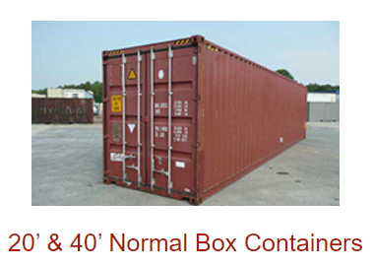
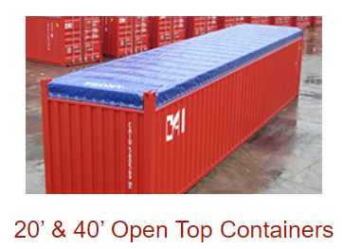
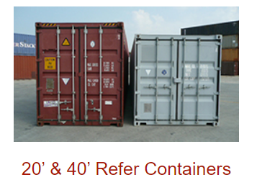
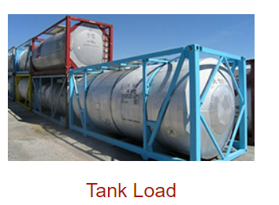
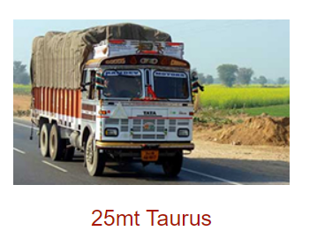
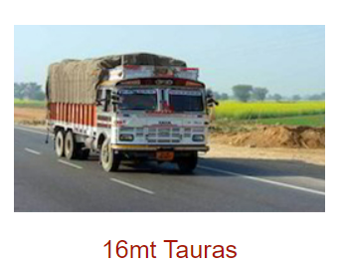
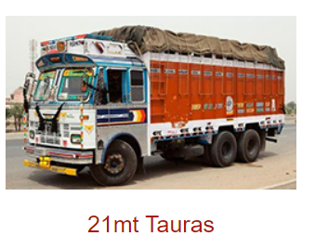
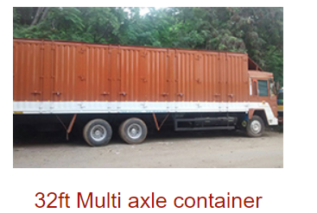
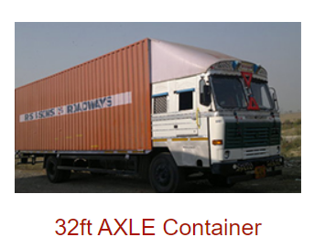
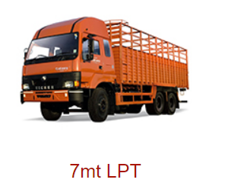
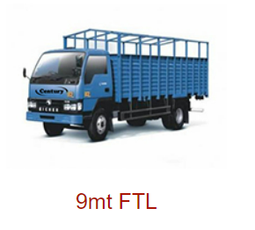
We Provide

Slide 5
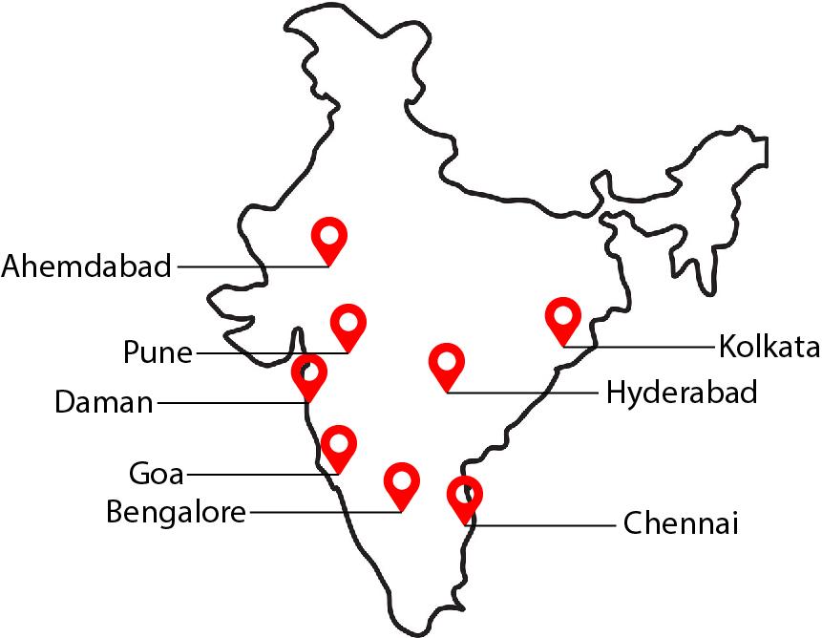
Our Branch
Branch | Branch Manager | Mobile No. | Email
GOA (Rgtd.office) | SK Poonia/Surander Khichar | 7972238814/9890940901 9370918585 / 7768993500 / 08322311189 | goa@mrcl.co.in skp@mrcl.co.in
PUNE | Ganesh Sharma | 8830064281 / 9370918582 | pune@mrcl.co.in
DAMAN | Surjeet | 9370918583 | daman@mrcl.co.in
CHENNAI | Shanmuganathan s | 9209003010/9890940901 | chennai@mrcl.co.in
AHMEDABAD | Surendra Fagireya | 9978671177 | ahemdabad@mrcl.co.in
BANGLORE | Ramesh Bedwal | 9370918584 | bangalore@mrcl.co.in
HYDERABAD | Omkar | 9393536576 | goa@mrcl.co.in
KOLKATA Noida/Manesar | Pinku Giri Arvid | 6290263127 9209003008 | kolkata@mrcl.co.in Noida@mrcl.co.in
North: Delhi, Gurgaon, Noida, Ghaziabad, Bhiwadi, Chandigarh, Jaipur, Hisar, Jammu
South: Chennai, Hyderabad & Bangalore
East: Raipur Kolkata, Vijaywada & Guwahati
West: Indore, Vapi, Baroda, Ahmadabad, Bhiwandi, & Nagpur, Pune

Slide 6
Ranges of Services Offered
As a leading logistic service provider. we hold expertise in offering transportation and relocation of any kind of cargo across India and the world. Our well-established nationwide network as well as services of Professionals provide us a strong & secure base for all the logistical needs our client.
The broad portfolios of services include the following:
Multimodal Transport Operation
One of the excellent door to door pickup and delivery model in the industry
Storage & Warehousing facility
Value added services
Fully compliant with laws – All Licenses and Permits are in place

Slide 7
Our Core Services
Transhipment
In Transit Storage
Transit Insurance
Last Mile Delivery
Just In Time Delivery
Multipoint Loading and Delivery
Bulk Transportation
Project Transportation.
ODA cargo services

Slide 8
Mission
To provide complete logistic solutions that is not only efficient but also reliable and affordable.
To gain confidence & trust of our valued clients by conducting business with complete honesty and Integrity.
Quality
Our operational excellence provides the foundation for the integrated logistics solutions that we offer to our Customers. The teams of skill professionals constantly monitor operational performance by maintaining PDCA (plan/do/check/action) cycle for continuous improvements. We focus on the development of highly Advanced logistics technology.
Achievements
We have consistently demonstrated a collaboration approach of working with customers to offer best Logistic solutions tailored to meet their individual needs. Our working methodology has enabled us to create a benchmark in the industry.

Slide 9
Convenience to Customers
We offer a convenient menu of standard freight management services including Air, Train and Road to Balance urgency and cost-effectiveness for your day-to-day shipment. Some of the factors that have helped us to evolve as the preferred logistics solution provider are as follows:
Competitive rates
Providing customized quality services.
Trailer-made logistics/outsourcing packages & computerized system for handling the specific needs of our customers.
Well knit national network with presence across 20 Cities.
Capability to handle of full load & part load consignment.
Goa to Ahmedabad, Bengaluru, Chennai, Nagpur, Pune ,Mumbai, Cochin. LCL door to door services.
Experience of handling logistic requirement.
A well maintained fleet of over 40 vehicles(including 32ft m/a containerized vehicle)
Continuous up gradation of technology, processes and systems.
Team of dedicated professionals.
Well trained professionals with experience in all aspects of transportation.

Slide 10
List of few Customers

Slide 11
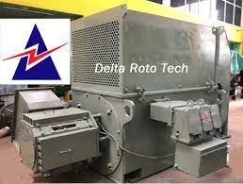
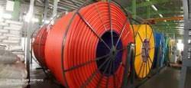

Slide 12
Contact Details
Location
Kurtarkar Nagari-26,
Flat No. S1,2nd Floor,
Shantinagar Ponda-Goa-403401
Email ID: goa@mrcl.co.in / skp@mrcl.co.in
Number : 9370918585 / 7972238814
Website : www.mrcl.co.in

